Slide 1
Clickjacking — Ui Redressing
One of the more under rated attacks facing modern Web applications
Chetan Rawool (56)
Dinesh Tolani (68)
Jyoti Yadav (72)

Slide 2
OVERVIEW
What is ClickJacking ?
Demo
How Users can be Affected
How to protect Web Application
Previous ClickJacking Attacks
Conclusion

Slide 3
WHAT IS CLICKJACKING
Discovered in 2008-Robert Hansen, Jeremiah Grossman as a way to perform cross-domain attacks by 'hijacking 'user-initiated mouse clicks to perform actions that the user did not intend.
Attacker will choose a clickable region on a website that the user is currently authenticated on (e.g. a 'Submit' button that will perform a particular action).
To perform the attack, a malicious website will load a page from the website inside an iFrame made fully transparent and layered on top of another element on the site.

Slide 4
Previously Stated: ClickJacking is one of the more under rated attacks facing modern Web applications.
This is one reason it doesn't find a mention in the OWASP Top 10 list so far but it is predicted to feature in the next version.

Slide 5
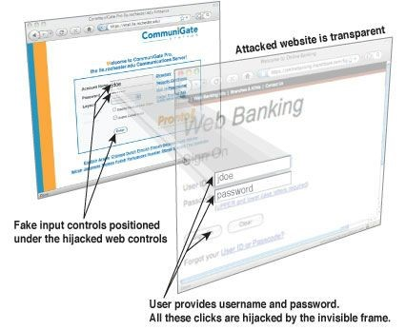
The mischievous <iframe> tag
A web page can embed another web page via iframe
<iframe src="http://www.target.site" </iframe>
CSS opacity attribute: i = visible, o = invisible

Slide 6
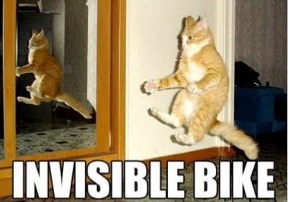
So basically;
Putting an evil invisible link on top of a legit visible link.

Slide 7
Demo
http://chetu45.blogspot.in/

Slide 8
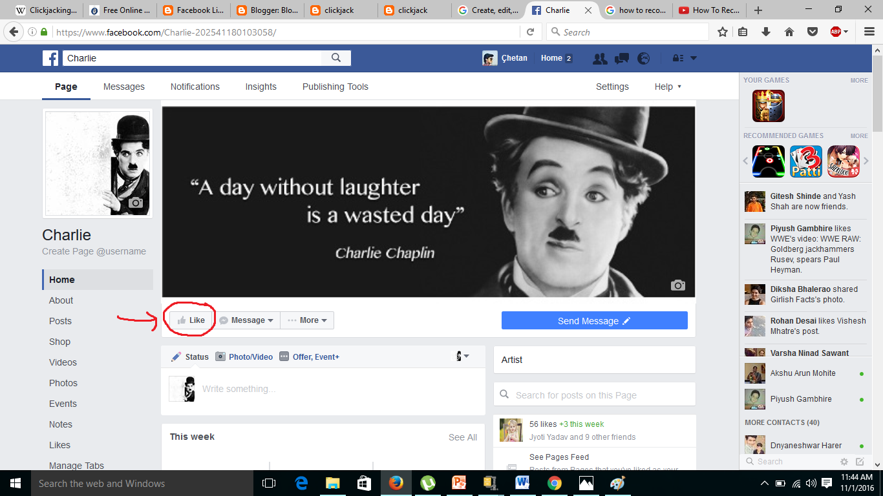

Slide 9
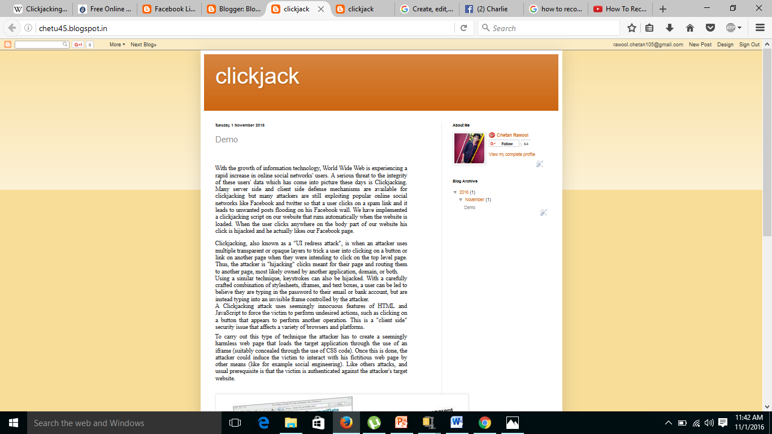

Slide 10
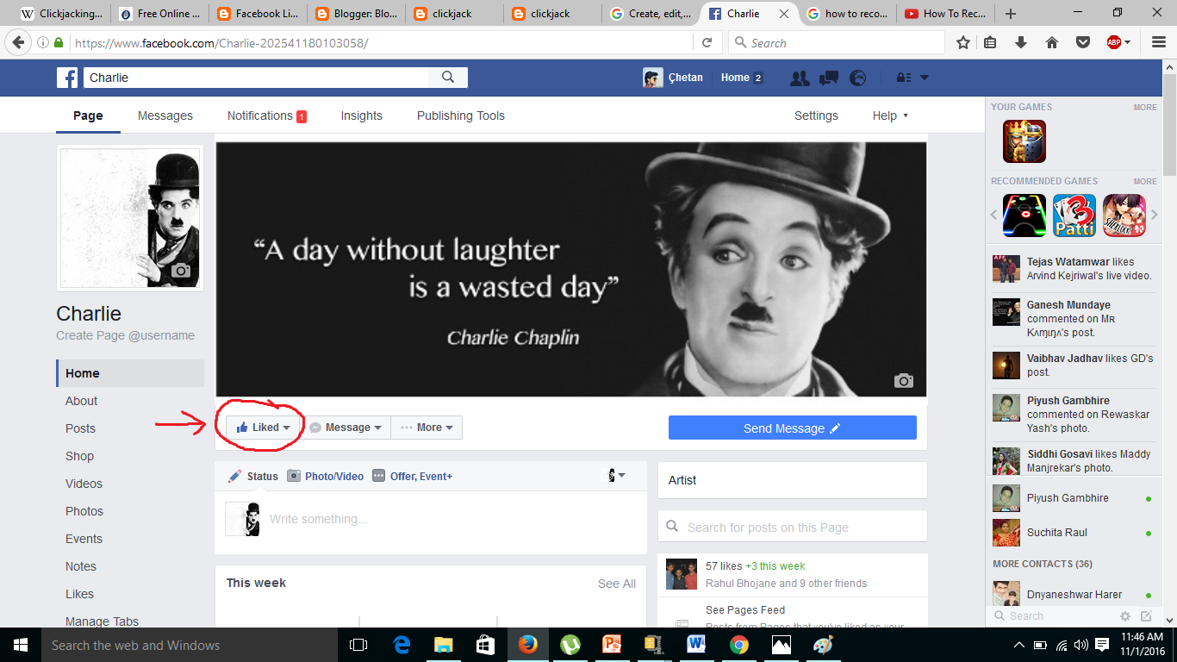

Slide 11
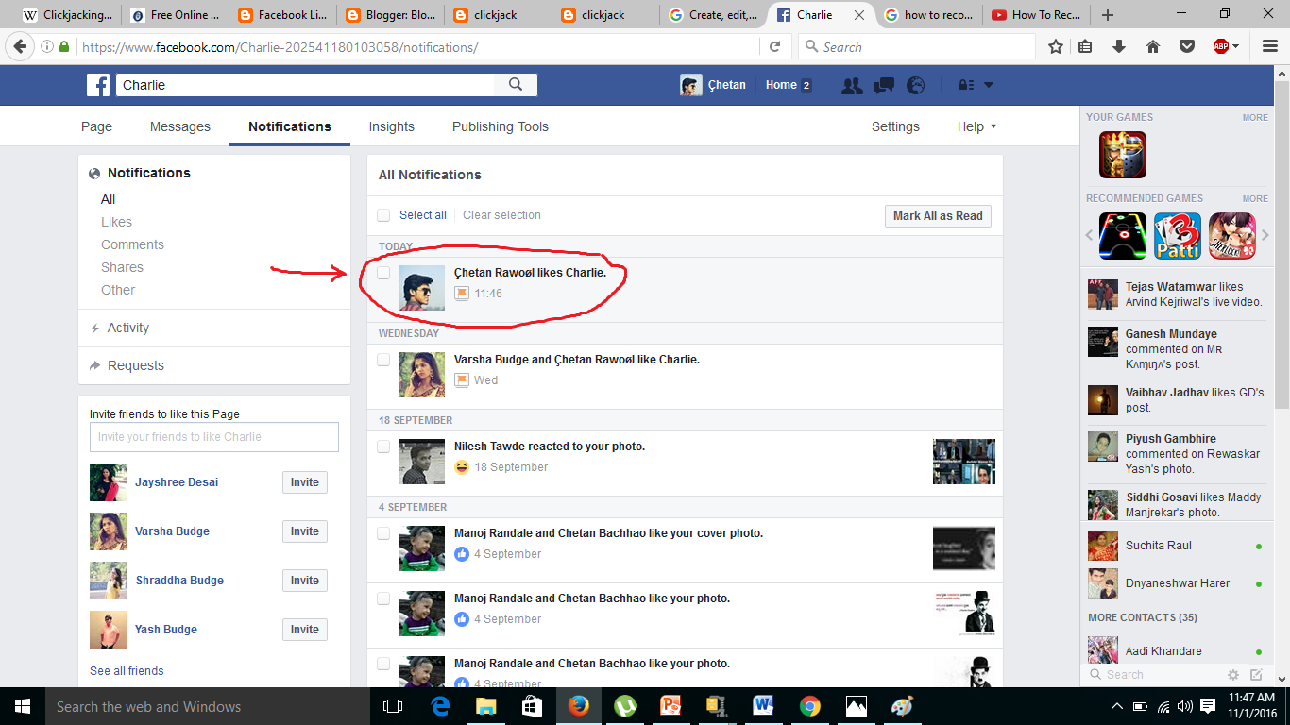

Slide 12
How Users can be Affected
Users can be tricked into clicking on obscured user interface elements of an application and in so doing initiate actions against their will, Such as;
Adding an attacker to a victim's social graph Promoting the attacker's content on a social network Sending a payment to the attacker
Compromising the user's session to impersonate the
victim user on the application
Tricking the user into submitting sensitive credential I information
Performing a privileged action on behalf of the user (Create or Delete accounts, etc..)

Slide 13
How to protect against clickjacking
Frame busting
A page using this method will detect that is has been framed by another web site, and attempt to load itself in place of the site that is framing it (thus 'busting out' of the frame).
Common Frame Busting Code
<script type="text/javascripe>
if (top != self) { //condition
top.location = selflocation;//counter action
} </script>
However, a malicious site may try to use the onunload and on beforeunload page events to prevent a framed site from navigating to a different URL.
Also JavaScript can be easily Disabled.

Slide 14
Previous ClickJacking Attacks
Twitter
Exploit: Force twitter users to post a message
Facebook
Exploit: Force users to Like
Advertising and Affiliate Networks
Force users to click on ads for $$$ CYBER CRIME CASH $$S
Adobe Flash
Adjust the privacy settings to turn on the camera and microphone

Slide 15
Conclusion
Attackers can trick victim browsers into clicking on things in victim websites by putting that website in a transparent iframe.
Many users still use old browsers, leaving them at risk from ClickJacking.
Also any client side validation with JavaScript is easily turned off.
The good news
ClickJacking is simple to prevent.
The bad news
The vulnerability is powerful and prevalent.
Many web applications have ClickJacking vulnerabilities.

Slide 16
THANK U

